Slide 1

Cloud Computing: The Future ofi IT
Cloud computing is transforming businesses. It delivers on-demand computing services. This includes servers, storage, and databases over the Internet. Discover how this technology is shaping the future.

Slide 2

Cost Savings with Cloud Computing
Reduced Capital Expenditure
Lower Operational Expenditure
Real-World Example
Netflix saves millions annually using AWS. Cloud solutions save money.
Eliminate hardware investments. Shift from owning to renting.
Reduce energy, IT staff, and maintenance costs. Save on resources.

Slide 3

Scalability and Flexibility
1 2
Scale Resources
Adjust resources based on demand. Scale up or down as needed.
Rapid Provisioning
Provision resources in minutes. Respond to changes quickly.
3
Global Expansion
Support global expansion. Enter new markets easily. Companies love this.

Slide 4
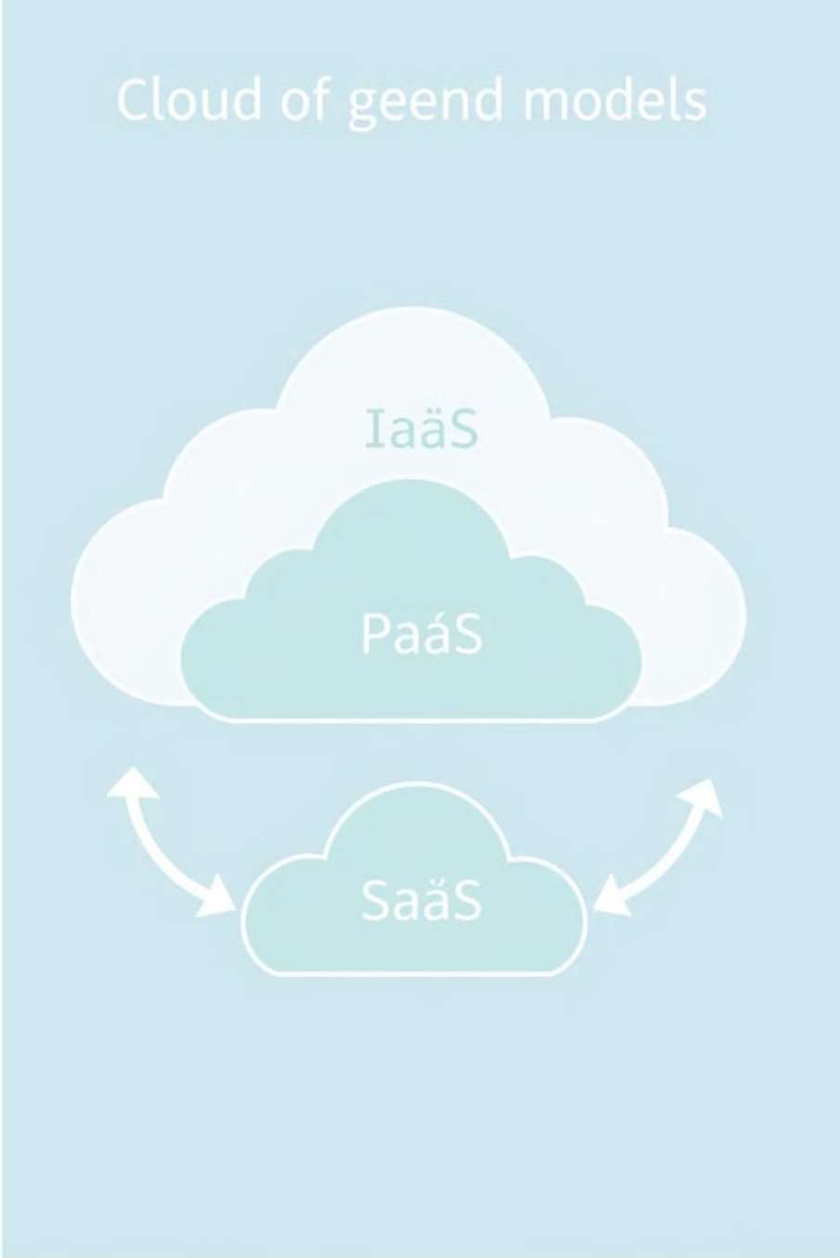

Cloud Service Models
IaaS
Virtualized computing infrastructure. AWS EC2 and Azure Virtual Machines are examples.
PaaS
Environment for application development. AWS Elastic Beanstalk and Google App Engine are good examples.
SaaS
Ready-to-use applications. Salesforce and Microsoft Office 365 are popular SaaS.

Slide 5

Cloud Deployment Models
Public Cloud
Shared infrastructure. AWS, Azure, and GCP are great examples.
Private Cloud
Exclusive infrastructure for a single organization. VMware and OpenStack are used.
Hybrid Cloud
Combination of public and private clouds. It enables burst capacity.

Slide 6


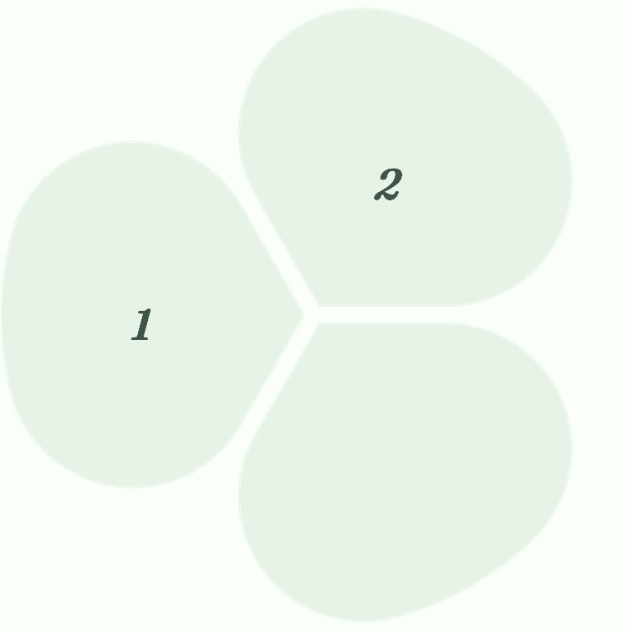
Shared Responsibility Model
Customer Security
Customers secure data and applications. Securing identities is important.
2
Provider Security
Cloud providers secure infrastructure. They protect your
data.
1
3
Security Measures
Encryption, access controls, and firewalls. Use identity management.

Slide 7
Challenges ofi Cloud Computing
Security
Data breaches and cyberattacks. Be aware of cyber security issues.
1
Compliance
Comply with regulations. GDPR and HIPAA are essential regulations.
2
Vendor Lock-in
Avoid vendor lock-in. It's hard to avoid it completely.
3

Slide 8




Cloud Computing in Action
Healthcare
Electronic health records and telemedicine. Use data analytics.
Finance
Online banking and fraud detection. Also, manage risks well.
Retail
E-commerce and supply chain management. Focus on customer CRM.

Slide 9

Future Trends in Cloud Computing
Serverless Computing
Focus on writing code. Don't manage servers.
1
2
AI and ML
Cloud platforms provide AI and ML. Very helpful and lucrative.
Edge Computing
Process data closer to the source. This will reduce
latency.
3

Slide 10

Embracing the Cloud
Cloud computing transforms industries. It offers cost savings and scalability. It provides greater flexibility. Strategic considerations are security and compliance. The future is serverless and in the cloud.
AI/ML and edge computing are the future.

Slide 11
THANK YOU!

